Slide 1
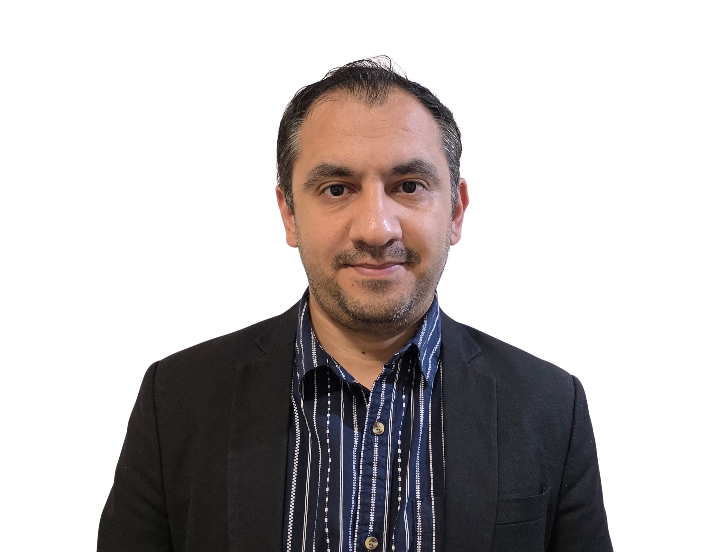
32555 – Fundamentals of Software Development

Slide 2
Welcome to 32555 – Fundamentals of Software Development
Your Teaching Team:
Dr. Yining Hu | Subject Coordinator
Yining is a Lecturer in Software Engineering. She works with many SMEs to develop software and AI solutions through student and research projects at UTS.
Contact: yining.hu@uts.edu.au
Dr. Xiaojie (Zoe) Lin | Tutor
Zoe is a full-stack software engineer with an interest in data analysis, specializing in JAVA, R, Python, JavaScript, PHP, Bash, and MATLAB; familiar with AWS.
Contact: Xiaojie.Lin@uts.edu.au
Dr. Farshid Keivanian | Tutor
Dr. Farshid Keivanian is an experienced university lecturer and researcher with a PhD in Information Technology. He has over 15 years of teaching experience across Australian institutions, specialising in software engineering, data science, AI, and cybersecurity.
Contact: Farshid.Keivanian@uts.edu.au
Yong Pov | Tutor
Yong is a full-stack software engineer with experience in React, JavaScript, TypeScript, Java, Python, SQL, and AI-assisted learning platforms.
Contact: Yong.Pov@uts.edu.au

Slide 3
Welcome to 32555 – Fundamentals of Software Development
Cmp1 # | Location | Time | Tutor
01 | CB11.B1.400 | Fri 16:00-18:00 | Xiaojie (Zoe) Lin
07 | CB11.B1.401 | Wed 10:00-12:00 | Farshid Keivanian
08 | CB11.B1.400 | Fri 12:00-14:00 | Yong Pov
09 | CB11.B1.103 | Wed 16:00-18:00 | Farshid Keivanian
10 | CB11.B1.401 | Wed 12:00-14:00 | Farshid Keivanian

Slide 4
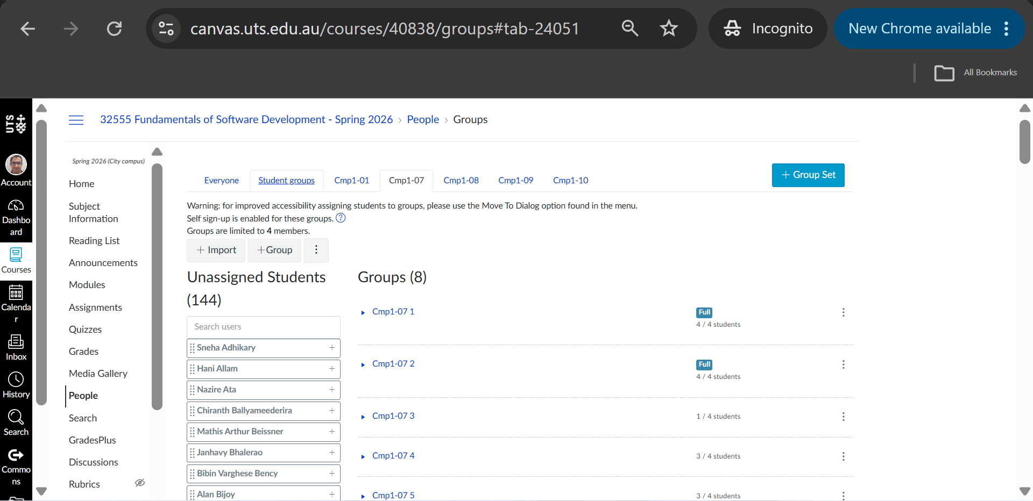
Have you attended your enrolled session?
Please attend the quiz during your enrolled session. Moving sessions will complicates the quiz set-up.
You can continue attending Cmp1# for labs and your project assignment.

Slide 5
Week 7 Outline
Quiz 1 Preparation: Guidelines & Practice Questions
Have you attended your enrolled session?
Group Assignment – Part 1: Clarification Slides
Project Brief – Simplified
Assignment 1 – Part 1: Admin, IDs, and Deliverables Clarified
Actors, User Stories, and ID Numbering Clarified
User Stories – Handling System Actions & Wording
Use Case & Class Diagrams – One Comprehensive View
Assignment 1 – Part 1: Use Case Diagram Clarifications
User Story Backlog – Clarified
UML Use Case Diagram — Clarified
UML Class Diagram — Clarified
Assignment 1 – Part 1: Class Diagram Design Clarifications
Assignment 1 – Part 1: CLI Representation, Data, and Relationships Clarified
Assignment 1 – Part 1: Scope, Traceability, and Contribution Clarifications
Marking Scheme
Deliverables & Contribution
Reference Note for Students

Slide 6
Quiz 1 Preparation: Guidelines & Practice Questions
What to Review • Review Modules 1–2 lecture notes, slides, and lab activities. • Focus on the following Quiz 1 topics: • Software development process and methodologies • Requirements analysis, including functional and non-functional requirements • Software design • Introduction to programming • Classes and objects

Slide 7
Quiz 1 Preparation: Guidelines & Practice Questions
• Basic OOP concepts: classes, objects, attributes, methods, encapsulation, inheritance, abstraction and polymorphism • UML use-case modelling: actors, associations, <<include>>, <<extend>> and generalization • UML class diagrams: relationships, inheritance/generalization, multiplicity and visibility • Programming fundamentals, including functions and procedures • Bring printed subject materials or access subject materials using the lab computer.

Slide 8
Quiz 1 Preparation: Guidelines & Practice Questions
During the Quiz
You have 30 minutes and only one attempt.
Each question has one correct answer.
Pace yourself: ~2 minutes per question.
Don’t get stuck—mark your best guess and move on.

Slide 9
Quiz 1 Preparation: Guidelines & Practice Questions
What to Do
Read each question carefully and identify key terms such as include, extend, association, inheritance, multiplicity, and visibility.
Pay attention to words such as NOT, required, every, one, many, superclass, and subclass.
Use elimination to rule out clearly incorrect options.
For code questions, analyse the code without executing it in an IDE.
Manage your time: 15 questions in 30 minutes.

Slide 10
Quiz 1 Preparation: Guidelines & Practice Questions
What NOT to Do
Do not use Generative AI tools, external websites, or other unauthorised resources.
Do not communicate or collaborate with other students during the quiz.
Do not use a personal computer or other personal device.
Do not execute code in an IDE.
Remember: you have one attempt only.

Slide 11
Quiz 1 Preparation: Guidelines & Practice Questions
Practice Questions
Which of the following best represents the relationship between Book Ride and Make Payment in a taxi app, assuming a payment is required for every booking?
a) Extend
b) Generalization
c) Include
d) Association
In UML use case diagrams, “include” means the base use case (Book Ride) always depends on and calls the included use case (Make Payment). Since payment is a required step in completing any booking, it cannot be skipped.
So: Book Ride includes Make Payment, because booking is not complete without payment.
Notes:
Include

Slide 12
Quiz 1 Preparation: Guidelines & Practice Questions
Practice Questions
In a video game, MiniMap and Inventory are separate classes that communicate with each other to update information displayed to the player. Which UML relationship best represents their connection?
a) Generalization b) Aggregation c) Association d) Multiplicity (1..*)
Association represents a relationship between two separate classes whose objects interact or communicate.
MiniMap is not a specialised type of Inventory, so it is not generalization.
Notes:
Association

Slide 13
Quiz 1 Preparation: Guidelines & Practice Questions
Practice Questions
In a video game, MiniMap and Inventory are separate classes that communicate with each other to update information displayed to the player. Which UML relationship best represents their connection?
a) Generalization b) Aggregation c) Association d) Multiplicity (1..*)
Neither class is described as a part of the other, so it is not aggregation.
Multiplicity (e.g., 1..*) describes how many objects participate in a relationship; it is not a relationship type itself.
Notes:
Association

Slide 14
Quiz 1 Preparation: Guidelines & Practice Questions
Practice Questions
In a video game, both MiniMap and Inventory are displayed on the screen. Which UML relationship is correct?
a) Generalization
b) Aggregation
c) Association
d) Multiplicity (1..*)
There is no "whole–part" relationship (so not Aggregation), and neither one is a specialized form of the other (so not Generalization). Multiplicity (1..*) just describes how many instances exist but is not itself a relationship type.
Therefore, the correct choice is Association, since MiniMap and Inventory are just linked as separate features shown together.
Notes:
Association

Slide 15
Quiz 1 Preparation: Guidelines & Practice Questions
Practice Questions
In UML, what kind of relationship shows that an actor is involved in a use-case?
a) Association
b) Include
c) Extend
d) Generalization
In UML use case diagrams, a line connecting an actor (like a user) to a use case (like “Book Ride”) is an association.
This shows the actor participates in or interacts with that use case.
The other options (include, extend, generalization) describe relationships between use cases, not between an actor and a use case.
Notes:
a) Association

Slide 16
Quiz 1 Preparation: Guidelines & Practice Questions
Practice Questions
In UML, what kind of relationship shows that an actor is involved in a use-case?
a) Association
b) Include
c) Extend
d) Generalization
So: An actor is connected to a use case with an Association relationship.
Notes:
a) Association

Slide 17
Quiz 1 Preparation: Guidelines & Practice Questions
Practice Questions
In a role-playing game, each Quest can provide several BonusItems. What diagram represents this?
a) 1 Quest → many BonusItems
b) many Quests → 1 BonusItem
c) Inheritance
d) Use dependency
The relationship described is that one quest can give multiple bonus items.
That is a one-to-many association (1..*) in UML.
Notes:
a) 1 Quest → many BonusItems

Slide 18
Quiz 1 Preparation: Guidelines & Practice Questions
Practice Questions
In a role-playing game, each Quest can provide several BonusItems. What diagram represents this?
a) 1 Quest → many BonusItems
b) many Quests → 1 BonusItem
c) Inheritance
d) Use dependency
It’s not inheritance (because BonusItem is not a subtype of Quest), and not use dependency (because BonusItems don’t define behavior of Quest, they are just rewards).
Notes:
a) 1 Quest → many BonusItems

Slide 19
Quiz 1 Preparation: Guidelines & Practice Questions
Practice Questions
In a role-playing game, each Quest can provide several BonusItems. What diagram represents this?
a) 1 Quest → many BonusItems
b) many Quests → 1 BonusItem
c) Inheritance
d) Use dependency
Option b would mean the reverse (many quests give only one item), which doesn’t match the description.
So the diagram is 1 Quest → many BonusItems (one-to-many association).
Notes:
a) 1 Quest → many BonusItems

Slide 20
Quiz 1 Preparation: Guidelines & Practice Questions
Which statement correctly describes the difference between procedural and OOP styles?
a) OOP organizes code into reusable classes and objects.
b) Procedural always hides data in classes.
c) OOP shares all global variables between methods.
d) Procedural is identical to object-oriented.
Procedural programming is step-by-step, with functions and procedures operating on data separately.
Notes:
a) OOP organizes code into reusable classes and objects.

Slide 21
Quiz 1 Preparation: Guidelines & Practice Questions
Which statement correctly describes the difference between procedural and OOP styles?
a) OOP organizes code into reusable classes and objects.
b) Procedural always hides data in classes.
c) OOP shares all global variables between methods.
d) Procedural is identical to object-oriented.
Object-oriented programming (OOP) groups both data and behavior together inside classes and objects, making code reusable and easier to manage.
Notes:
a) OOP organizes code into reusable classes and objects.

Slide 22
Quiz 1 Preparation: Guidelines & Practice Questions
Which statement correctly describes the difference between procedural and OOP styles?
a) OOP organizes code into reusable classes and objects.
b) Procedural always hides data in classes.
c) OOP shares all global variables between methods.
d) Procedural is identical to object-oriented.
The other options are incorrect because:
(b) Procedural does not hide data in classes (that’s OOP’s job).
(c) OOP does not automatically share all global variables between methods.
(d) Procedural and OOP are not identical.
So, the key difference: OOP = classes and objects; Procedural = functions and steps.
Notes:
a) OOP organizes code into reusable classes and objects.

Slide 23
Quiz 1 Preparation: Guidelines & Practice Questions
Practice Questions
Which of the following OOP principles are supported by Python?
a) Encapsulation b) Inheritance c) Polymorphism d) Abstraction e) All of the above
Python supports all four major OOP principles. Python supports encapsulation primarily through classes, naming conventions and name mangling; inheritance through superclass/subclass relationships; polymorphism through mechanisms such as method overriding and duck typing; and abstraction through mechanisms such as abstract base classes.
Notes:
e) All of the above

Slide 24
Quiz 1 Preparation: Guidelines & Practice Questions
Practice Questions
Abstraction → Achieved through abstract base classes (abc module) or by hiding implementation details behind methods.
Python, as a fully object-oriented language, supports all four core OOP principles.
Which OOP principle is fully supported by Python?
a) Encapsulation
b) Inheritance
c) Polymorphism
d) Abstraction
e) All of the above
Notes:
e) All of the above

Slide 25
Quiz 1 Preparation: Guidelines & Practice Questions
Practice Questions
An actor represents an external role, person, organisation, or external system/device that interacts with the system being modelled.
The system being modelled is not its own actor.
Which of the following is NOT suitable as an actor in a use-case model?
a) Online Banking System
b) Bank Customer
c) Security Guard
d) Teller Machine
Notes:
a) Online Banking System

Slide 26
Quiz 1 Preparation: Guidelines & Practice Questions
Practice Questions
So while the Bank Customer, Security Guard, and Teller Machine can all act as external actors, the Online Banking System is the system boundary, not an actor.
Therefore, Online Banking System is NOT suitable as an actor.
Which of the following is NOT suitable as an actor in a use-case model?
a) Online Banking System
b) Bank Customer
c) Security Guard
d) Teller Machine
Notes:
a) Online Banking System

Slide 27
Quiz 1 Preparation: Guidelines & Practice Questions
Practice Questions
Agile is all about flexibility — requirements can change anytime through the backlog and user stories.
(a) Continuous testing each cycle → Agile promotes iterative testing.
Which of the following is NOT an advantage of Agile?
a) Continuous testing each cycle
b) Requirements remain fixed throughout the project
c) Flexible backlog with user-story changes
d) Active customer collaboration
Notes:
b) Requirements remain fixed throughout the project

Slide 28
Quiz 1 Preparation: Guidelines & Practice Questions
Practice Questions
(c) Flexible backlog → Agile backlog evolves with feedback.
(d) Active customer collaboration → Core Agile principle.
Fixed requirements go against Agile, so (b) is NOT an advantage.
Which of the following is NOT an advantage of Agile?
a) Continuous testing each cycle
b) Requirements remain fixed throughout the project
c) Flexible backlog with user-story changes
d) Active customer collaboration
Notes:
b) Requirements remain fixed throughout the project

Slide 29
Quiz 1 Preparation: Guidelines & Practice Questions
Practice Questions
A class is the blueprint.
An object is a real instance created from that class.
It carries attributes (data) and methods (behavior).
Options (a), (c), and (d) confuse the role of classes vs. objects.
So: Object = a working instance of a class with data + behavior.
In OOP, what is an object?
a) Blueprint to create classes
b) A class instance with attributes and methods
c) A method header only
d) A template that contains only functions
Notes:
b) A class instance with attributes and methods

Slide 30
Quiz 1 Preparation: Guidelines & Practice Questions
Practice Questions
A function performs a task and returns a value (e.g., sum(2,3) returns 5).
A procedure performs a task but does not return a value (it just executes steps).
Which is correct about functions vs. procedures?
a) Functions always return a value
b) Procedures return values like functions
c) Functions cannot be assigned to variables
d) Functions and procedures are identical
Notes:
a) Functions always return a value

Slide 31
Quiz 1 Preparation: Guidelines & Practice Questions
Practice Questions
(b) is wrong → procedures don’t normally return values.
(c) is wrong → functions can be assigned to variables.
(d) is wrong → they are not identical, their purpose differs.
So: Functions return values; procedures just carry out actions.
Which is correct about functions vs. procedures?
a) Functions always return a value
b) Procedures return values like functions
c) Functions cannot be assigned to variables
d) Functions and procedures are identical
Notes:
a) Functions always return a value

Slide 32
Quiz 1 Preparation: Guidelines & Practice Questions
Practice Questions
Which symbol denotes a protected field in UML?
a) +
b) -
c) #
d) ~
+ → Public
- → Private
# → Protected (accessible to the class itself and its subclasses)
~ → Package (default, accessible within the same package)
So, in UML: Protected field = #
Notes:
c) #

Slide 33
Quiz 1 Preparation: Guidelines & Practice Questions
Practice Questions
Inheritance means a child class can reuse attributes/methods of its parent.
Protected (#) members are designed for inheritance → they are accessible within the class and its subclasses.
Inheritance usually involves what type of attribute visibility?
a) Public
b) Protected
c) Private
d) Package
Notes:
b) Protected

Slide 34
Quiz 1 Preparation: Guidelines & Practice Questions
Practice Questions
Public members are visible everywhere (not just inheritance).
Private members are hidden from subclasses.
Package (~) is limited to classes in the same package.
So: Inheritance usually works with protected attributes.
Inheritance usually involves what type of attribute visibility?
a) Public
b) Protected
c) Private
d) Package
Notes:
b) Protected

Slide 35
Quiz 1 Preparation: Guidelines & Practice Questions
Practice Questions
Attributes are variables inside a class that store information about the object’s state (e.g., name, age in a Person class).
(b) Local variables exist only inside a method, not across the whole object.
(c) Methods are behaviors, not attributes.
What are attributes in a class?
a) Data fields that describe state
b) Local variables inside methods
c) Methods that perform actions
d) Class operations
Notes:
a) Data fields that describe state

Slide 36
Quiz 1 Preparation: Guidelines & Practice Questions
Practice Questions
(d) Class operations refer to actions, not stored data.
So: Attributes = data fields that hold the state of an object.
What are attributes in a class?
a) Data fields that describe state
b) Local variables inside methods
c) Methods that perform actions
d) Class operations
Notes:
a) Data fields that describe state

Slide 37
Quiz 1 Preparation: Guidelines & Practice Questions
Practice Questions
Functional requirements describe what the system does → actions like selecting a team, logging in, or choosing a stadium.
Non-functional requirements describe how well the system works → performance, speed, security, usability, etc.
Which of the following is a non-functional requirement in a Football Game app?
a) Player selects team
b) Player logs in with ID
c) Stadium selection
d) Login should validate credentials in less than 2 seconds
Notes:
d) Login should validate credentials in less than 2 seconds

Slide 38
Quiz 1 Preparation: Guidelines & Practice Questions
Practice Questions
Options (a), (b), and (c) are all functional.
Option (d) is about performance (time constraint), so it is non-functional.
So: (d) is the non-functional requirement.
Which of the following is a non-functional requirement in a Football Game app?
a) Player selects team
b) Player logs in with ID
c) Stadium selection
d) Login should validate credentials in less than 2 seconds
Notes:
d) Login should validate credentials in less than 2 seconds

Slide 39
Quiz 1 Preparation: Guidelines & Practice Questions
Practice Questions
Which of the following is a non-functional requirement for an online booking system?
a) The user can create an account. b) The user can cancel a booking. c) The administrator can view all bookings. d) The system must display search results within 2 seconds.
Notes:
d) Login should validate credentials in less than 2 seconds

Slide 40
Quiz 1 Preparation: Guidelines & Practice Questions
Functional requirements describe what the system does—features and behaviours. Non-functional requirements describe how well the system should operate, such as performance, security, reliability and usability.
Therefore, (d) is the non-functional requirement because it specifies a performance constraint.
Notes:
d) Login should validate credentials in less than 2 seconds

Slide 41
Quiz 1 Preparation: Guidelines & Practice Questions
During which software development activity are stakeholder needs identified, analysed and documented?
a) Implementation b) Testing c) Requirements analysis d) Deployment
Notes:
d) Login should validate credentials in less than 2 seconds

Slide 42
Quiz 1 Preparation: Guidelines & Practice Questions
Prepare for Quiz 1
Review all Modules 1–2 lecture notes, slides and lab activities.
Review software development processes and methodologies.
Understand requirements analysis, including functional vs. non-functional requirements.
Review software design and programming fundamentals.
Understand classes, objects, attributes, methods and core OOP principles.

Slide 43
Quiz 1 Preparation: Guidelines & Practice Questions
Review UML use-case modelling: actors, associations, include, extend and generalization.
Review UML class diagrams: relationships, inheritance, multiplicity and visibility.
Practice interpreting questions and diagrams rather than memorising answers.
Remember: 15 MCQs, 30 minutes, one attempt, restricted open-book, lab computer only.

Slide 44
Group Assignement – Part 1: Clarification Slides
These slides are prepared to clarify each part of the assignment (scope, user stories, use case diagram, class diagram, rules, data file, etc.).
If you have any questions, please send me an email with the specific part you’d like me to explain further, and I will include it in the shared clarifications for everyone.
Remember: the main reference is the instructions on Canvas under Assignments → Part 1 – Analysis and Design. These slides are an additional guide to help you if anything seems confusing.

Slide 45
Project Brief – Simplified
Student role: register → log in → enrol / drop subjects → view subjects → change password (Students must register → log in → do student actions: enrol/drop/view/change password)
Admin role: view and manage student data (Admins can view/manage student data)
System: saves all data to students.data (All data saved to students.data)
Scope: Command-line (CLI) system only (CLI system only (GUI is Part 2)) Not in scope: multiple semesters, fancy user interface (GUI comes in Part 2)

Slide 46
Project Brief – Simplified
Clarifying Actors
Student → a real user who registers, logs in, enrols, drops subjects, views enrolments, changes password.
Admin → a real user who views all students, groups by grade, removes a student, clears all data.
System → not a person, but we can include it in user stories when it does something automatically (e.g., generate ID, assign marks/grades, validate password).

Slide 47
Project Brief – Simplified
Avoid mistake:
The CLI (command-line) and GUI (graphical interface) are just tools to access the system. They are not actors.
Key takeaway:
Actors = who interacts with the system (Student, Admin).
System = does background tasks.
CLI/GUI = just the interface, not actors.

Slide 48
Project Brief – Simplified
Actors in UML use-case diagrams are usually the people/external roles interacting with the system.
The System itself is not drawn as an actor — it’s the boundary box that contains all use cases.

Slide 49
Project Brief – Simplified
So here:
Student → external actor
Admin → external actor
System → not an actor (it’s the thing being modelled)
Therefore, we really have two actors: Student and Admin. The System is the box that holds use cases (e.g., Register, Log in, Enrol, Drop, View, Change Password, Manage Data).

Slide 50
Assignment 1 – Part 1: Admin, IDs, and Deliverables Clarified
Dear Dr. Farshid Keivanian,
I hope this message finds you well.
I am a student from 32555-Fundamental of Software Development cmp-…, and I have some questions regarding Assignment 1. Subject ID Generation
Who is responsible for generating the subject ID? (Admin / System)
Is there any limitation or format requirement for the subject ID?
2. Admin Login Credentials
According to the assignment outline, when an Admin logs into the system, should they use email and password or ID and password?
It is mentioned that Admins do not need to register an account, but it is unclear whether they should log in using an email or an ID. Could you please clarify?
3. Role Identification
If we choose to use email and password for login, how should we distinguish between Student and Admin roles?
Alternatively, if we use ID and password, is there a specific format or number of digits required for the Admin ID?
4. Assignment Requirements from Week 6 Slides
Based on the Week 6 and 7 slides, are we required to include scope, rules, data file design, and a traceability table in our submission?
Will these components be assessed or contribute to our marks?
I would really appreciate your help in answering these questions.
Best regards

Slide 51
Assignment 1 – Part 1: Admin, IDs, and Deliverables Clarified
Dear Student,
Thank you for your thoughtful questions regarding Assignment 1. I’m happy to clarify each point:
1. Subject ID Generation
The system is responsible for generating subject IDs automatically (not the Admin).
Subject IDs must be 3 digits, zero-padded (e.g., 001–999). This format is specified in the brief.

Slide 52
Assignment 1 – Part 1: Admin, IDs, and Deliverables Clarified
2. Admin Login Credentials
As per the assignment brief, Admins do not register accounts. They already exist in the system.
Admins therefore do not need email/password or ID/password login. They simply access the Admin subsystem directly without authentication.

Slide 53
Assignment 1 – Part 1: Admin, IDs, and Deliverables Clarified
3. Role Identification
Since Admins do not log in, there is no need to assign Admin IDs, emails, or passwords.
Only Students need email + password validation and a 6-digit ID.

Slide 54
Assignment 1 – Part 1: Admin, IDs, and Deliverables Clarified
4. Assignment Requirements (Week 6 & 7 Slides)
For Part 1 (Analysis & Design), your submission must include:
Scope summary
User-story backlog (3-digit IDs, table format)
One comprehensive Use Case Diagram
One comprehensive Class Diagram
System rules (email, password, IDs, grade bands)
Example data file design (JSON or CSV format, design only, no coding)
Contribution plan

Slide 55
Assignment 1 – Part 1: Admin, IDs, and Deliverables Clarified
The “traceability” check (requirements → stories → diagrams) is recommended as a quality step, but it is not a separate marking criterion.
The main marks come from backlog (5), use case diagram (5), and class diagram (5), for a total of 15 marks.
Key takeaway: Subject IDs = generated by system (3 digits). Admins = no login needed. Students = email/password + 6-digit ID. Required deliverables are those listed above.
I hope this clears things up. Please also refer to the official assignment instructions on Canvas for final reference.
Best regards, Dr. Farshid Keivanian 32555 – Fundamentals of Software Engineering

Slide 56
Assignment 1 – Part 1: Use Case Diagram Clarifications
Dear Teacher,
For the UC diagram question:
There is confusion in declaring use cases for us, since, for instance, Enroll in Subject is done by actor Student, Assign Random Subject, and Mark are internal operations from the system (which is not the actor), so do we have to include them in the diagram or it will just stop at Enroll in Subject

Slide 57
Assignment 1 – Part 1: Use Case Diagram Clarifications
Dear Student,
That’s an excellent and very important question—thank you for raising it.
In a Use Case Diagram, you only show interactions between external actors (Student, Admin) and the system. Internal tasks like assigning random subject IDs, generating marks, or validating emails are system responsibilities, but they are not separate actors.

Slide 58
Assignment 1 – Part 1: Use Case Diagram Clarifications
Here’s the rule of thumb for this assignment:
Show the main action as a use case (e.g., Enroll in Subject).
If the system always performs an internal step (e.g., Generate ID, Assign Random Mark, Calculate Grade), you may model it as an <<include>> use case connected to the main one.
You do not need to introduce “System” as an actor. Keep actors limited to Student and Admin.

Slide 59
Assignment 1 – Part 1: Use Case Diagram Clarifications
So in your example (diagram):
Student → Enrol in Subject (main use case).
Assign Random Subject, Assign Random Mark, and Calculate Grade can be <<include>> use cases linked to Enrol in Subject.
The diagram should stop at the external action (Enrol in Subject) and then use include/extend for the internal logic, instead of showing them as if they were done by an actor.

Slide 60
Assignment 1 – Part 1: Use Case Diagram Clarifications
This way, your diagram remains aligned with the assignment brief: actors are only Student and Admin, and system actions are shown as part of use case flows, not as new actors.
Kind regards,
Farshid

Slide 61
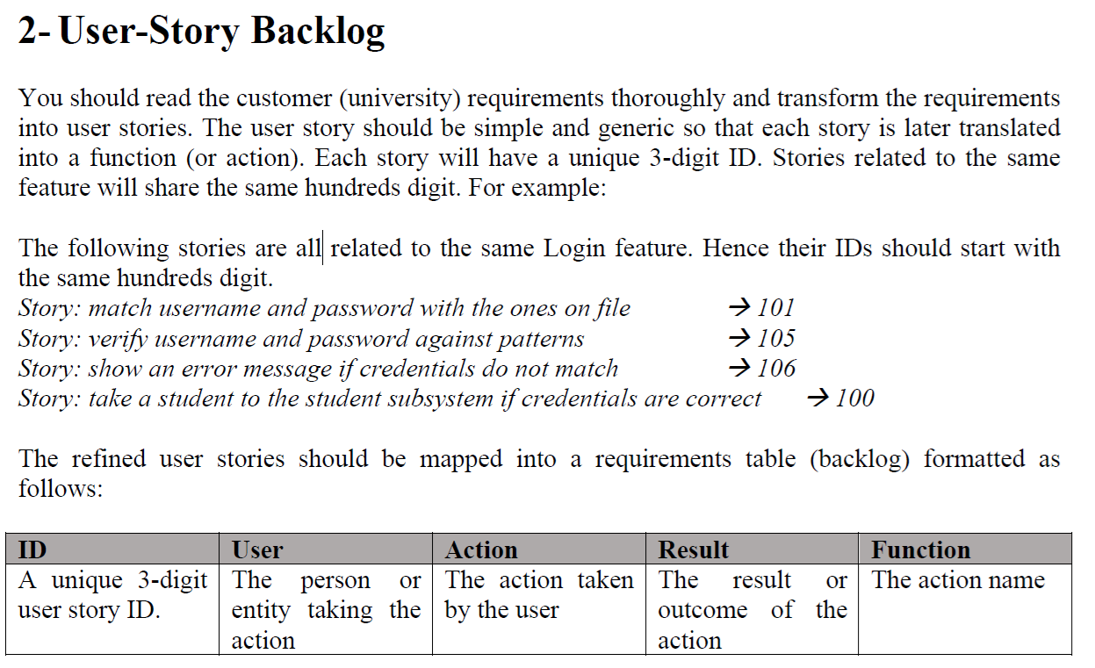
User Story Backlog – Clarified

Slide 62
User Story Backlog – Clarified
What this section is asking for?
Turn the brief into tiny tasks (“user stories”). What it is: Small tasks written as “stories.”
Give each story a 3-digit ID. Stories for the same feature share the same hundreds digit (e.g., all Login stories = 1xx). ID rule: 3 digits → same hundreds digit = same feature.

Slide 63
User Story Backlog – Clarified
Example:
100 Student logs in with email/password → success/fail → login()
105 System validates credentials → error message → validateCredentials()
Put stories in a table with columns: ID, User, Action, Result, Function (Function = the future code hook name). Format: ID | User | Action | Result | Function.

Slide 64
User Story Backlog – Clarified
List the features from the brief Login, Register, Enrol, Drop, View Enrolments, Change Password, Admin Views, Admin Group/Partition, Admin Remove/Clear, File I/O.
Make small, single-action stories for each feature One clear action → one clear outcome (no “and then…”).

Slide 65
User Story Backlog – Clarified
Assign 3-digit IDs Pick a scheme and stick to it. Example: 1xx Login, 2xx Register, 3xx Enrol, 4xx Drop, 5xx View, 6xx Change PW, 7xx Admin, 8xx File I/O. Use gaps (100, 101, 105…) so you can add more later.

Slide 66
User Story Backlog – Clarified
Fill the backlog table
ID: your 3-digit code
User: Student / Admin / System
Action: what they do
Result: what the system shows/returns/changes
Function: future method name (e.g., login())

Slide 67
User Story Backlog – Clarified
5. Quick check Does every requirement in the brief appear in at least one story? Are outcomes testable?

Slide 68
Tiny example
ID | User | Action | Result/Outcome | Function
100 | Student | Submit email & password to log in | If match → go to Student Menu | login()
105 | System | Validate email & password patterns | Show specific error on invalid pattern | validateCredentials()
200 | Student | Register with name/email/password | Account created + 6-digit ID assigned | registerStudent()
201 | System | Generate unique 6-digit student ID | ID like 004231 | generateStudentId()
300 | Student | Enrol (no subject choice) | One new subject added with 3-digit code | enrolSubject()
301 | System | Block enrolment over 4 | Message “Maximum of 4 subjects reached” | checkMaxSubjects()
320 | System | Auto-assign mark & compute grade | Subject has mark 25–100 and grade Z/P/C/D/HD | assignMarkAndGrade()
500 | Student | View current enrolments | List subjects with IDs, marks, grades | listSubjects()
730 | Admin | Remove a specific student | Student record deleted | adminRemoveStudent()
740 | Admin | Clear all data | students.data emptied after confirm | adminClearAll()

Slide 69
User Story Backlog – Clarified
What to avoid
X Don’ts
Mixed stories → “log in and enrol and view” (too much in one).
Inconsistent IDs → don’t jump between 1xx/2xx for the same feature.
UI/implementation details → “click green button”, “use SQL”.
Missing outcomes → always show what user/system gets.
Extra actors → CLI/GUI are not actors (only Student, Admin, System).

Slide 70
User Story Backlog – Clarified
What to do
✔ Do’s
Break down into small stories (2–5 per feature).
Use Student/Admin/System only.
Group IDs: 1xx = Login, 2xx = Register, 3xx = Enrol, etc.
Keep one clear action → one clear outcome.
Keep it behavioural, not technical.

Slide 71
User Story Backlog – Clarified
Question and Answers (FAQ)
Do we need more than 3 digits?
No. Stay with 3 digits; you won’t exceed 9–10 features.
How many stories per feature?
A few atomic ones (2–5) are typical—enough to cover all rules in the brief.
Can “System” be the user?
Yes—when the system performs internal actions (e.g., generate ID, validate patterns).

Slide 72
Actors, User Stories, and ID Numbering Clarified
Dear Dr. Keivanian, I am a student in 32555 - Fundamentals of Software Engineering, and I have some questions regarding the first assignment. These are: 1. Are the CLI and GUI systems, which convert users' commands into function calls, considered "actors"? 2. I have done some reading and found out that there are primary actors and secondary (supporting) actors. It seems that sometimes the "computer system" can be considered a secondary actor that provides some service (validating email pattern, saving data, etc.), like illustrated in the attached picture. Are we supposed to identify secondary actors in this assignment? If we have to classify secondary actors, do we have to write user stories for them? 3. The brief says that the user story IDs have to have 3 digits, with the hundredth digit specifying the feature number, but if we have more than 10 features, how should we assign numbers to the features (i.e. is it 1000, 1001, etc.)? 4. Are the user stories more detailed steps for achieving a feature? For example, the feature is "enroll", and it is broken down into 3 user stories: (101) adding subject, (102) removing subjects, (103) viewing subjects. Or is this too specific, and we should have one user story for one feature? I would really appreciate your help in answering these questions. Thank you very much! Best regards,

Slide 73
Actors, User Stories, and ID Numbering Clarified
1. Are CLI/GUI systems “actors”?
No.
Actors are people or external systems that interact with your system.
In this assignment: Student and Admin are the main actors.
CLI and GUI are just interfaces (ways to use the system), not actors.

Slide 74
Actors, User Stories, and ID Numbering Clarified
2. Do we need secondary actors (like Credit Authorizer in the diagram)?
In our assignment, you don’t need to add secondary/supporting actors.
Things like validating emails, saving data are internal system tasks, not separate actors.
So: only focus on Student and Admin.

Slide 75
Actors, User Stories, and ID Numbering Clarified
3. User story IDs – what if more than 10 features?
Each feature uses its own “hundreds digit”.
Example: Login → 100 series, Register → 200 series.
You won’t have more than 9–10 top features here (the brief is smaller).
Keep IDs 3-digit (e.g., 101, 102, 103).
Don’t use 1000+. Stay with 3 digits only.

Slide 76
Actors, User Stories, and ID Numbering Clarified
4. Are user stories detailed steps or one story per feature?
Think of a feature broken into a few simple stories.
Example (Feature = “Enrol”):
301: Add a subject automatically
302: Show error if >4 subjects
303: Generate subject mark + grade
So yes, one feature = a few small user stories.

Slide 77
Actors, User Stories, and ID Numbering Clarified
Key takeaway for students:
Actors: only Student and Admin
No secondary actors needed
User stories: break down features into simple steps
IDs: always 3 digits (100, 101, 102…)

Slide 78
User Stories – Handling System Actions & Wording
Dear Dr. Keivanian, Thank you for your insightful response. However, I still have some doubts about the assignment.
Regarding the second and fourth answer in your response, these raise another question, which is that in the assignment brief, the user stories will be mapped into a backlog table. However, the example user stories in the assignment brief have no actor in them (e.g. "match username and password with the ones on file"), but the backlog table contains a User field. I have two questions about this:
1. Some functions seem to not be executed by the student/admin, such as "verify username and password against patterns". What should these function's User be in the backlog table?
2. In Week 5's slide, the user story is formatted as "As a ..., I want to ... so that I can ...". Should we follow this format for the assignment or the one mentioned above in your previous email? And if we should follow the format in Week 5's slide, how should we express functions executed by the system? (e.g. "verify username and password against patterns")
I would really appreciate your help answering these questions. Thank you very much! Best regards,

Slide 79
User Stories – Handling System Actions & Wording
Hi Student,
Great follow-up—thanks for reading carefully. I’ve uploaded an updated Week 5 handout with clearer examples; it’s now on Canvas. Below is a concise answer you can use right away.
Clarification: “User” in the backlog & story wording
1) Who is the “User” when the step isn’t done by Student/Admin? Use System in the User column for internal steps (validation, ID generation, saving/loading, etc.). You do not need extra/secondary actors.

Slide 80
User Stories – Handling System Actions & Wording
Example (Login feature, 1xx):
100 | Student | Submit email & password | If match → go to Student menu | login()
105 | System | Validate email/password pattern | Pattern error shown if invalid | validateCredentials()
110 | System | Compare credentials with file | Success/Failure decided | checkCredentials()
120 | System | Show “credentials don’t match” | Error message displayed | showAuthError()

Slide 81
User Stories – Handling System Actions & Wording
2) Which user-story wording should we follow? Either style is acceptable—just be consistent:
Concise style (like the brief): “Verify username and password against patterns.”
In the table: User = System, Action = Validate credentials, Result = Error shown if invalid.
“As a … I want … so that …” style (Week 5 slide):
“As a system, I validate the email/password so that only correctly formatted credentials are accepted.”
In the table, still put System in the User column.

Slide 82
User Stories – Handling System Actions & Wording
Markers care that your stories are atomic, testable, correctly mapped, and that User is Student / Admin / System only. Don’t invent actors (CLI/GUI ≠ actors).
Quick checklist (for your team)
Use 3-digit IDs grouped by feature (1xx Login, 2xx Register, …).
Keep one action per story (no “and then…”).
Map every requirement → at least one story → appears in your Use Case and Class diagrams.
Internal tasks = System as the user.

Slide 83
User Stories – Handling System Actions & Wording
Main reference remains the Canvas assignment page; the slides are there to guide you: https://canvas.uts.edu.au/courses/36509/assignments
If anything else feels fuzzy, ping me and I’ll fold it into the shared clarifications.
Best Regards, Dr. Farshid Keivanian 32555 — Fundamentals of Software Engineering

Slide 84
User Stories – Handling System Actions & Wording
In short:
Who is the “User” in backlog?
Use Student or Admin when they act.
Use System for internal steps (validation, ID generation, saving/loading).
Don’t invent new actors (CLI/GUI ≠ actors).
Example (Login, 1xx series):
100 | Student | Submit email & password → Student menu if valid
105 | System | Validate email/password → Show error if invalid

Slide 85
User Stories – Handling System Actions & Wording
Wording styles:
Concise: “Verify username and password against patterns.”
Long: “As a system, I validate email/password so that only valid ones are accepted.” Both are fine — just stay consistent.

Slide 86
User Stories – Handling System Actions & Wording
Checklist:
3-digit IDs grouped by feature (1xx Login, 2xx Register, …).
One action per story.
Every requirement → at least one story → seen in UC + Class diagrams.
Main reference = Canvas Assignment 1 page.

Slide 87
Use Case & Class Diagrams – One Comprehensive View
Dear Dr. Farshid,
I am Kevin from Group 4 from Tuesday 4-6 p.m tutorial. I have a question regarding the Assessment 1.
On the assessment, we have to add UML use case diagram and UML class diagram. Should we make them separately according to each category e.g one for registration, one for enrolment or could we just combine them altogether ?
Thank you
Best regards,

Slide 88
Use Case & Class Diagrams – One Comprehensive View
Dear Student,
Thank you for your question. For Assessment 1 – Part 1, you should create one comprehensive UML Use Case diagram and one comprehensive UML Class diagram that cover the entire system, not separate diagrams for each feature (e.g., registration, enrolment).
This means:

Slide 89
Use Case & Class Diagrams – One Comprehensive View
All student operations (register, enrol, drop, view, change password) and admin operations (view, group PASS/FAIL, remove student, clear data) should appear in a single Use Case diagram, connected to the relevant actors.
The Class diagram should represent all core classes (e.g., Student, Subject, DataStore, AuthService, Admin role/class) in one diagram, with attributes, methods, and relationships.

Slide 90
Use Case & Class Diagrams – One Comprehensive View
This ensures consistency and traceability across the system and aligns with the assignment brief and marking criteria.
Best regards, Dr. Farshid Keivanian

Slide 91
User Story Backlog — Clarified
What it is: Small tasks written as “stories.”
Format: ID | User | Action | Result | Function.
ID rule: 3 digits → same hundreds digit = same feature.
Example:
100 Student logs in with email/password → success/fail → login()
105 System validates credentials → error message → validateCredentials()

Slide 92
User Story Backlog — Clarified
Step-by-step (Do’s & Don’ts)
✔ Break down into small stories (2–5 per feature). ✔ Use Student/Admin/System only. ✔ Group IDs (1xx = Login, 2xx = Register, 3xx = Enrol, etc). X Don’t combine multiple actions in one story. X Don’t add UI details. X Don’t invent new actors.

Slide 93
UML Use Case Diagram — Clarified
Shows who (actor) does what (use case).
Add relationships:
<<include>> → always happens.
<<extend>> → sometimes happens.
Example:
Student → Register (includes Validate Email, Generate ID).
Student → Enrol (includes Assign Mark & Grade, Save Data).
Login → extend → Show Error.
Avoid adding CLI/GUI as use cases. Only focus on real user/system actions.

Slide 94
UML Class Diagram — Clarified
Classes: Student, Subject, Admin, DataStore.
Attributes (fields): id, name, email, etc.
Methods: enrol(), drop(), view().
Visibility:
+ public (accessible everywhere).
- private (class only).
# protected (class + children).

Slide 95
UML Class Diagram — Clarified
Relationships:
Student ↔ Subject (association, 1..4).
Permit ↔ Vehicle (composition example).
Student/Admin → inherit from User (generalization).
Avoid: mixing too many details (keep it high-level, consistent with Part 2 code).

Slide 96
Assignment 1 – Part 1: Sample Diagrams & Feedback
Dear Professor,
I hope this message finds you well.
Our group has been working on the assignment, and we would like to kindly ask for your feedback.
Could you please review our current content and let us know if any errors or areas require adjustment?
We want to make sure that we are on the right track before proceeding further. Your guidance would be greatly appreciated.
Thank you very much for your time and support.
Best regards,

Slide 97
Assignment 1 – Part 1: Sample Diagrams & Feedback
Dear Student,
Thank you for sharing your draft report and diagrams — it is clear that your team has put significant effort into aligning your work with the assignment brief. I reviewed both the use case diagram and the class diagram, and overall you are on the right track. A few clarifications and suggestions:
Use Case Diagram
Good job showing both Student and Admin actors clearly.
Internal system actions (e.g., validate email/password, generate IDs, assign random marks, save/load data) are correctly modeled as <<include>> relationships.

Slide 98
Assignment 1 – Part 1: Sample Diagrams & Feedback
Error-handling via <<extend>> (e.g., invalid credentials, weak password, subject not found) is accurate.
Tip: keep UC labels concise (e.g., “UC200 Register” rather than “Register account”) but ensure naming matches your backlog table.
Class Diagram
Splitting responsibilities into Student, Subject, Admin, StudentRepository, Validator, IdGenerator, and GradeCalculator is well done.
Associations and multiplicities (Student 1 → 0..4 Subjects) are correct.
Including students.data as a file artifact is a nice touch.

Slide 99
Assignment 1 – Part 1: Sample Diagrams & Feedback
Small refinement: You could treat Validator, IdGenerator, and GradeCalculator as utility/service classes (static-style), but it is acceptable to show them as full classes as you have done.
Admin does not require attributes (like adminId) for this assignment — modelling it as a role/controller with only management functions is sufficient.

Slide 100
Assignment 1 – Part 1: Sample Diagrams & Feedback
General Feedback
Your backlog, use case diagram, and class diagram are consistent, which is a key marking criterion.
Your report structure is clear, and your system rules align with the Part 1 brief (email, password, ID formats, enrolment cap, mark ranges, grade bands, PASS/FAIL rule).
At this stage, no major corrections are required — only minor refinements for naming consistency and clarity.

Slide 101
Assignment 1 – Part 1: Sample Diagrams & Feedback
You are progressing very well — if you keep the consistency between backlog → use case → class diagram, your submission will meet the assessment requirements.
Best regards, Dr. Farshid Keivanian

Slide 102
Assignment 1 – Part 1: Class Diagram Design Clarifications
Dear Dr. Keivanian,
We are Group #... – Tuesday 4 PM (Cmp1-01) in [32555 Fundamentals of Software Development].
we are aligning our class diagram design with the five classes shown in your “Week 5 – Preparation for Group Assignment” slide (Student, Subject, AuthService, DataStore, Admin). We have a few questions.
This is our class diagram draft,

Slide 103
Assignment 1 – Part 1: Class Diagram Design Clarifications
Question 1
Should changePassword method live in Student (self-management of credentials) or in AuthService (relates to security concern)? Would placing it in both classes be acceptable, or is that redundant for this assignment?
Question 2 marks and grades seem to belong to the Student–Subject relationship. would it be acceptable to make an association class (such as Enrolment) to model this relationship? Or should we keep the mark and grade attributes inside the Subject class?
Question 3 And also, some examples add a separate utility class to centralize validateEmail, validatePassword, and generateStudentId. Would adding such a class be appropriate, or would you prefer we keep these functions inside the existing five classes?

Slide 104
Assignment 1 – Part 1: Class Diagram Design Clarifications
Question 4
For Admin class, should we include attributes such as adminId or name, email (treating Admin as a real user), or is it sufficient for Admin to expose only management functions (e.g., list students, delete student, view grades)? I’m not entirely sure, but in a previous lab (Bank System), I didn’t model an Admin login, so I wanted to clarify it.
Since this is our first time working on analysis and design of development process, we may find some parts challenging and might make a few mistakes along the way. We kindly ask for your understanding. Thank you so much!

Slide 105
Assignment 1 – Part 1: Class Diagram Design Clarifications
Dear students,
Thank you for sharing your thoughtful draft and questions. It’s great to see your group working carefully on the design. Please find clarifications below:
Q1. changePassword – Student vs AuthService
For this assignment, it is acceptable to place changePassword inside AuthService, since it relates to authentication/security logic.
If you also show it inside Student as a self-operation, that may be seen as redundant. To keep your diagram clean and consistent, I recommend placing it in AuthService only.

Slide 106
Assignment 1 – Part 1: Class Diagram Design Clarifications
Q2. Marks/Grades – association class vs Subject
You are right: marks and grades belong to the enrolment relationship (Student ↔ Subject), not inside Subject itself.
If you want to be precise, you may introduce an association class (Enrolment) that holds mark and grade.
Alternatively, you can store them as part of the Student’s enrolment map (Student → Subject + mark/grade). Either is acceptable, but avoid putting mark and grade directly inside Subject.

Slide 107
Assignment 1 – Part 1: Class Diagram Design Clarifications
Q3. Utility class for validation/ID generation
Adding a utility/helper class (e.g., Validator or IdGenerator) is fine in real-world systems.
For this assignment, it is simpler to keep validateEmail, validatePassword, and generateStudentId inside AuthService (since that class already handles registration/login).
You don’t lose marks either way, but sticking to the 5 main classes (Student, Subject, AuthService, DataStore, Admin) keeps your diagram consistent with the brief.

Slide 108
Assignment 1 – Part 1: Class Diagram Design Clarifications
Q4. Admin class attributes
In this assignment, Admins don’t need registration or login (they are predefined).
So you don’t need to add adminId, email, or password as attributes.
It is sufficient for Admin to only expose the required management operations (listStudents, deleteStudent, viewGrades, clearData, etc.).
Treat Admin as a role/facade, not as a full user entity like Student.

Slide 109
Assignment 1 – Part 1: Class Diagram Design Clarifications
Key takeaway: Keep your class diagram simple and aligned with the assignment brief. Stick with the five main classes, place changePassword in AuthService, model marks/grades in the Student–Subject relationship (not Subject directly), keep validation logic in AuthService, and treat Admin as an operations role only.
You’re on the right track — very good progress so far. Don’t worry about overcomplicating the design; clarity and alignment with requirements are what matter most.
Best regards, Dr. Farshid Keivanian

Slide 110
Assignment 1 – Part 1: CLI Representation, Data, and Relationships Clarified
Hi Professor, I hope you're well. Our group is currently working on Assessment 1 – Part 1, and we have a few questions regarding the CLIUniApp and how it should be represented in our requirement planning document: How should we integrate the CLI into our requirement planning? Should we reflect CLI functionalities in the use case diagram and user story backlog only, or is there another diagram/table we should include? For the class diagram, do we need to provide examples of actual data rows (e.g., in JSON format), or is it sufficient to just design the class structure and relationships? Should linking fields such as student_id in the enrolment table be explicitly included in the class diagram to show relationships between classes? Also, may we ask which slide(s) in the lecture materials would be most helpful for us to refer to when designing our diagrams and fulfilling the assignment requirements? Would providing the use case diagram and class diagram be sufficient for you to clarify these questions? Thank you very much for your guidance! Best regards,

Slide 111
Assignment 1 – Part 1: CLI Representation, Data, and Relationships Clarified
Dear Student,
Thank you for sharing your diagrams and questions — you are on the right track. Let me clarify each point for Assignment 1 – Part 1:
1) Representing the CLI The CLI (CLIUniApp) is just the interface to the system, not an actor. You don’t need to model CLI itself in the class diagram. Instead:
In the Use Case Diagram, just focus on Student and Admin as the actors.
In the User Story Backlog, describe actions they perform through the CLI (e.g., “Student enrols in subject”). No extra diagram/table is required beyond backlog + diagrams already listed.

Slide 112
Assignment 1 – Part 1: CLI Representation, Data, and Relationships Clarified
2) Class Diagram vs Data Examples For Part 1, you only need to design class structure and relationships (attributes, methods, multiplicities). You do not need to provide actual data rows (e.g., JSON/CSV) in the class diagram. Data format design is optional and only for illustration.
3) Linking Fields (IDs in Enrolment) Yes — linking fields like student_id and subject_id in your Enrolment class are correct and a good way to explicitly model the relationships. This matches the requirement that each Student can enrol in up to 4 Subjects.

Slide 113
Assignment 1 – Part 1: CLI Representation, Data, and Relationships Clarified
4) Reference Slides The most relevant are:
Week 5: Step-by-Step Tasks and System Rules
Week 6/7: Use Case & Class Diagram Clarifications These cover scope, user story backlog, and how to align UC and Class diagrams with the brief.

Slide 114
Assignment 1 – Part 1: CLI Representation, Data, and Relationships Clarified
5) Submission Expectation Yes — providing the Use Case Diagram and Class Diagram, alongside your backlog table, is sufficient to meet Part 1 deliverables. You don’t need to add extra diagrams for CLI or data tables.

Slide 115
Assignment 1 – Part 1: CLI Representation, Data, and Relationships Clarified
Key takeaway:
CLI is not an actor — model Student/Admin actions only.
Class diagram = structure, not sample data.
Linking IDs in Enrolment is correct.
Use backlog + UC + Class diagrams as your core deliverables.
You are on the right track — keep refining clarity and consistency, and you’ll align perfectly with Part 1 requirements.
Best regards, Dr. Farshid Keivanian

Slide 116
Assignment 1 – Part 1: Scope, Traceability, and Contribution Clarifications
Dear Dr. Farshid Keivanian,
I hope this message finds you well.
I am a student from 32555-Fundamental of Software Development cmp-08, and I have some questions regarding Assignment 1 part 1:
With user stories backlogs, do we also need include the user stories, or is the requirements table itself fine.
Do we need to worry about duplicate results for students who are enrolled in more than 1 subject when the admin views grade/category.
Questions about Scope Summary and tiny traceabiliy table and Contribution:
What exactly should be included in the Scope Summary and Tiny Traceability Table?
According to Assignment Task 1 on Canva, the main marks are allocated to the User Story, Use Case Diagram and Class Diagram. Are there any mark allocated to the Scope, Data File Design and Tiny Traceability Table?
Regarding to the Contribution section: if a teammate did not contribute to the main marked conponents(e.g. Use Case Diagram),but contributed to Data File Design or Tiny Traceability Table, how should we reflect his/her contribution?
Should we express contribution as a percentage, or is it acceptable to simply describe who worked on which parts and who assisted with what?
Thank you very much for your time and guidance.
Kind regards,

Slide 117
Assignment 1 – Part 1: Scope, Traceability, and Contribution Clarifications
Dear Student,
Thank you for your thoughtful questions. These are very relevant, and I’ll include them in the shared clarification slides so the whole class benefits. Below is a concise response for you now:
1. User Story Backlog Yes, you must include the user stories in a requirements table (the backlog). The table itself is the required format — just ensure each row corresponds to a clear user story with ID, User, Action, Result, and Function.

Slide 118
Assignment 1 – Part 1: Scope, Traceability, and Contribution Clarifications
2. Duplicate Results for Admin Views You do not need to handle duplicate results in Part 1. The focus is on design and requirements analysis, not implementation detail. Simply showing that an admin can view and group students by grade or PASS/FAIL is enough.
3. Scope Summary & Tiny Traceability Table
Scope Summary: A short section listing what is in scope (Student and Admin operations, system rules) and what is out of scope (GUI, multi-semester enrolments).

Slide 119
Assignment 1 – Part 1: Scope, Traceability, and Contribution Clarifications
Tiny Traceability Table: A brief table that links requirements → user stories → use cases → class diagram. It doesn’t need to be long; the goal is to show consistency.
4. Marks for Scope, Data File Design, Traceability The marking rubric (on Canvas) awards marks mainly for User Story Backlog, Use Case Diagram, and Class Diagram. Scope, data file design, and traceability are supporting sections. They don’t have separate marks, but they help demonstrate completeness, consistency, and professionalism, which supports your grade.

Slide 120
Assignment 1 – Part 1: Scope, Traceability, and Contribution Clarifications
5. Contribution Section
Contributions should reflect who worked on which part, including supporting sections (scope, data file, traceability).
It’s acceptable to write “Member A: User Stories + Traceability, Member B: Use Case Diagram, Member C: Class Diagram, Member D: Data File Design + proofreading”.
Percentages are not required. A clear description of contributions and assistance is enough.

Slide 121
Assignment 1 – Part 1: Scope, Traceability, and Contribution Clarifications
Key takeaway: Focus marks are on Backlog + Use Case + Class Diagram, but supporting sections (scope, traceability, data file design) are expected in the report. Contributions should reflect all work, not just the marked sections.
Best regards, Dr. Farshid Keivanian

Slide 122
Marking Scheme
How You’ll Be Marked (15 marks)
User story backlog (5) → specific, consistent, correct IDs.
Use case diagram (5) → correct actors/relationships, labelled.
Class diagram (5) → correct classes, fields, methods, multiplicity.

Slide 123
Deliverables & Contribution
Submit one .docx or .pdf per group.
File name: group<group-number>-Cmp1<lab-number>.docx.
Equal contribution (Sparkplus peer rating).
Due: Sunday, Week 7.
Late = penalties.
Misconduct = 0.
Extra Clarification:
Work together on backlog, use case, class diagram.
Keep it consistent across all parts (story IDs → functions → later code).
Don’t wait until last day — diagrams + backlog take time to refine.

Slide 124
Reference Note for Students
The main reference for this assignment is the official instructions provided on Canvas: Assignments – Part 1: Analysis and Design
This PowerPoint is designed to guide you and clarify the task where things might feel confusing. If you are ever unsure, please always go back to the official Canvas instructions as the source of truth.

Slide 125

Happy Learning and Bright Futures Ahead! Dr. Farshid Keivanian Stay Connected: linkedin.com/in/farshid-keivanian github.com/FarshidKeivanian
Education is the most powerful weapon you can use to change the world. — Nelson Mandela

